Slide 1
A linear time algorithm for max-min length triangulation of a convex polygon
Shiyan Hu
Information Processing Letters 101 (2007), pp. 203 ~ 208
Presenter : Hsiang - Yi Weng
Date : March 12, 2008

Slide 2
Abstract
We consider the following planar max-min length
triangulation problem: given a set of n points in
the Euclidean plane, find a triangulation such that
the length of the shortest edge in the triangulation
is maximized. In this paper, a linear time algorithm
is proposed for computing the max-min length
triangulation of a set of points in convex position.

Slide 3
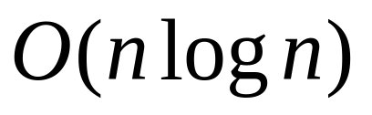
Abstract (cont.)
In addition, an time algorithm is
proposed for computing the max-min length
k-set triangulation of a set of points in convex
position, where we are to compute a set of k
vertices such that the max-min length
triangulation on them is minimized over all
possible k-set.

Slide 4
Abstract (cont.)
We further show that the graph version of
max-min length triangulation is NP-complete,
and some common heuristics such as greedy
algorithm are in general not able to give a
bounded-ratio approximation to the max-min
length triangulation.

Slide 5
Max-min length triangulation

Slide 6
Max-min length triangulation of a convex polygon
n=8

Slide 7

Observation 1.
In any convex polygon, there are at most
two inner angles which can be smaller than .

Slide 8
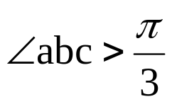
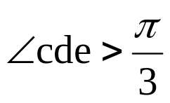
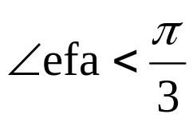
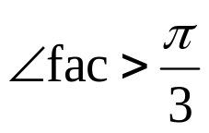
由a點開始，順時針方向
c
“cut”
b
d
“cut”
a
e
“left untouched”
Check next vertex “a”
“cut”
f

Slide 9
Theorem 2.
Given a convex polygon, the max-min length
triangulation on hull vertices can be computed
in linear time and a shortest edge in the
triangulation lies on the convex polygon.

Slide 10
Inner angle of each vertex can be either cut or left untouched depending on the comparison result of its inner angle with .
2. We only need to add a linear number of edges for the triangulation.
3. We always add an edge no shorter than some previously added edges (or hull edges).
4. A shortest edge of any max-min length triangulation for a convex polygon is a shortest edge on the convex polygon.

Slide 11
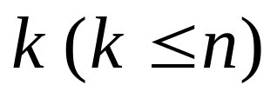
Computing max-min length k-set triangulation for a convex polygon
Compute a set of vertices (called a k-
set) such that the max-min length triangulation
on these vertices is minimized over all possible
k-set.

Slide 12

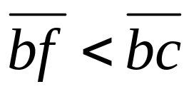
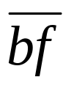
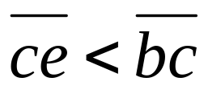
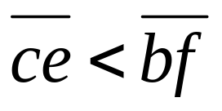
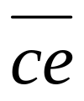
a
b
c
b, c, d, e, f 共五點
最短邊
f
d
e
The max-min length 5-set triangulation on 6 hull vertices
a, b, c, e, f 共五點
最短邊
Output 找到 a, b, c, e, f

Slide 13
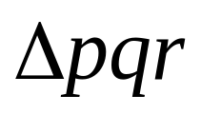
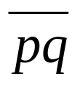

Observation 3.
For any triangle with base edge , if is
shorter than all edges along a convex path inside
the triangle (starting from p and ending with q),
the bounding triangle for the convex path and
must have vertex angle (opposite to ) smaller
than .

Slide 14
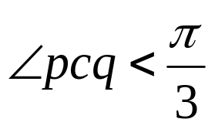
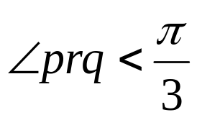
q
b
c
r
a
p

Slide 15

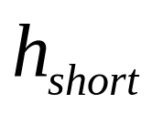
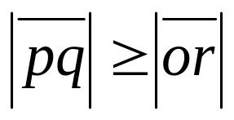
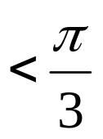
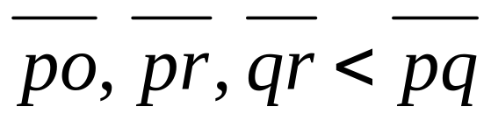
Suppose that two crossing inner edges and are both shorter than , and without loss of generality, assume that
p
o
This contradicts the fact that any convex quadrilateral can have at most two inner angle smaller than .
r
q

Slide 16
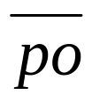


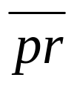
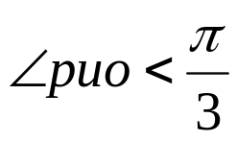
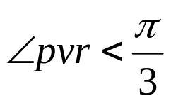
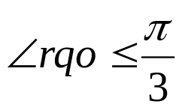
We can have at most two edges out of , , , shorter than . Without loss of generality, we assume
that only and are shorter than and thus .
u
p
o
l
v
q
r

Slide 17
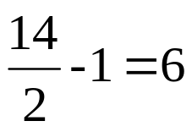
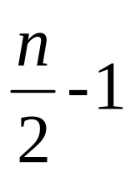
We have shown that no pair of crossing inner edges
can be both shorter than . It readily follows that one can have at most n edges shorter than in any
convex polygon.
edges shorter than .

Slide 18
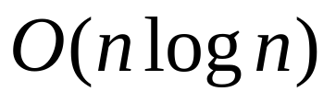
Theorem 4.
Given a convex polygon, the max-min length
k-set triangulation on n hull vertices can be
computed in time.

Slide 19
Conclusion
An optimal linear time algorithm for computing the max-min length triangulation of a convex polygon.
The max-min length k-set triangulation of a convex polygon can be computed in time.
The graph version of the max-min length triangulation problem is NP-complete.
Several common heuristics are not applicable for computing the general max-min Euclidean length triangulation.

